Slide 1
The iTunes setup can be downloaded from the iTunes website, and also it can be installed on the home computer. Once the installation and the registration are done, iTunes application can easily interconnect with the Apple iTunes store. Users can purchase and download music, video,TV serials, etc. and cache it in the media library

Slide 2




What is Design Pattern
Design pattern is a general reusable solution to a commonly occurring problem in software design.
A design pattern is not a finished design that can be transformed directly into code. It is a description or template for how to solve a problem that can be used in many different situations.

Slide 3

Why Design Patterns
•To design a new software system quickly and efficiently.
•To understand a existing software system.

Slide 4

Introduction
Promote reuse.
Use the experiences of software developers.
A shared library/lingo used by developers.
“Design patterns help a designer get a design right faster”.

Slide 5

Introduction
Based on the principles of object-oriented programming: abstraction, inheritance, polymorphism and association.
Are solutions to recurring problems to software design.
Are independent of the application domain.
Example – Variability of interfaces – the modeller view controller (MVC) pattern.

Slide 6

The Downside
Although design patterns are useful in promoting flexibility, this maybe at the expense of a more complicated design.
There does not exist
A standardization for indexing patterns
General practices/processes for using design patterns during the design process have not as yet been established.

Slide 7

Object-Oriented Principles
Involves identifying:
Classes and objects
What to encapsulate
Association hierarchies
Inheritance hierarchies
Interface hierarchies
Object-oriented designs are evaluated in terms of how reusable, extensible and maintainable they are.

Slide 8

Types of Pattern – Catalog 1
Creational patterns
Focus on Object creation.
Focus on the best way to create instances of objects to promote flexibility, e.g. factory pattern.
Structural patterns
Focus on Relationship between entities.
Focus on the composition of classes and objects into larger structures, e.g. the adapter pattern.
Behavioural patterns
Focus on Communication between objects
Focus on the interaction between classes or objects,
e.g. the observer pattern.

Slide 9

Types of Pattern – Catalog 2
Architectural patterns
Focus on the form of the overall system.
Design patterns
Focus on the form of the subsystems making up the overall system and essentially provides schemes for refining them.

Slide 10

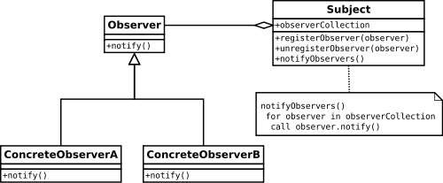
Observer Design Pattern
•Observer Design Pattern is a software design pattern in which an object, called the subject, maintains a list of its dependents, called observers, and notifies them automatically of any state changes, usually by calling one of their methods.
•Type : Behavioral pattern.

Slide 11

Factory Design Pattern
Define an interface for creating an object, but let the subclasses decide which class to instantiate. The Factory method lets a class defer instantiation to subclasses.
Type : Creational pattern.

Slide 12

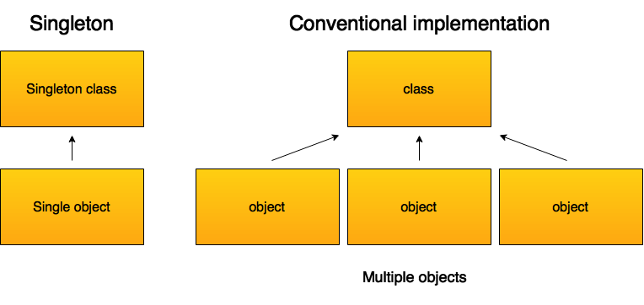
Singleton Design Pattern
Ensure a class has only one instance, and provide a global point of access to it.
Encapsulated “just-in-time initialization” or “initialization on first use”.
Type : Creational pattern.

Slide 13

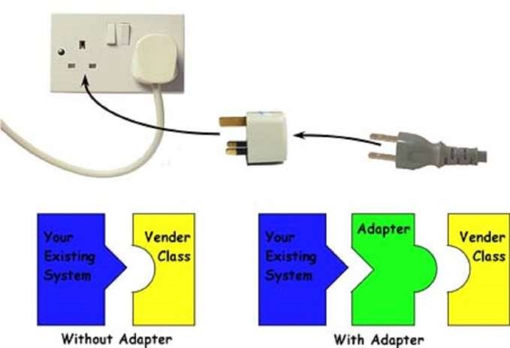
Adaptor Design pattern
 The adapter pattern (often referred to as the wrapper pattern or simply a wrapper) is a design pattern that translatesone interface for a class into a compatible interface.

Slide 14

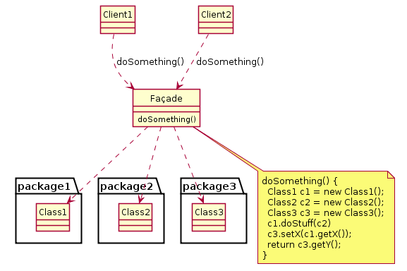
Façade pattern
A facade is an object that provides a simplified interface to a larger body of code, such as a class library.
Type: Structural Design Pattern.

Slide 15
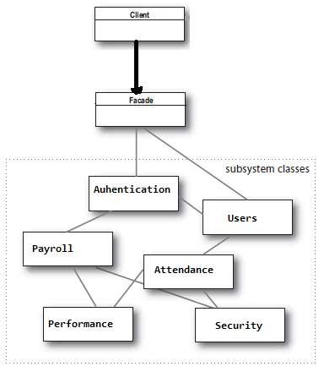
Façade pattern

Slide 16

Pattern Scope
The scope of a pattern specifies whether the pattern applies to classes or objects.
Class patterns describe relationships between classes and their subclasses. These relationships are static.
Object patterns describe the relationships between objects. Theses relationships can be changed at runtime.

Slide 17

Defining Patterns
Are defined in terms of classes and objects and relationships between them.
Using existing well-tested patterns saves time instead of deriving them from scratch each time.
Patterns usually consist of smaller patterns/sub- patterns.
Class diagrams are used to express design patterns.

Slide 18

Core Components of a Pattern
The problem which the pattern was used to solve and the situation giving rise to the problem. A list of the conditions that must be met in order to apply the pattern may also be included.
The core solution to the problem in terms of a description of the design rather than implementation details.
Uses of the solution

Slide 19

A More Detailed Definition
Name
Intent of the pattern
Aliases
The problem
Solution
Example/s
Applicability
Structure
Participants
Collaborations
Implementation
Sample code
Known uses
Related patterns
Consequences

